Slide 1


K.RAMAKRISHNAN COLLEGE OF TECHNOLOGY
(AUTONOMOUS), TRICHY.
DEPARTMENT OF
COMPUTER SCIENCE AND ENGINEERING
20CS5501 DESIGN PROJECT-1
Batch No. : 17
Date : 07.12.2024

Slide 2
SMART GPA CALCULATOR: DYNAMIC SOLUTION FOR ACADEMIC PERFORMANCE​
Guided by Team
Mr. R. Vignesh Kumar, M.E., Santhosh B (811722104132)
Assistant Professor, CSE Seralathan S (811722104136)
Vasan S (811722104177)

Slide 3
OBJECTIVE OF THE PROJECT
Automation of Calculations: Simplify and automate the process of calculating SGPA and CGPA, ensuring accuracy and minimizing errors common with manual calculations. ​
Elimination of Manual Errors: Address mistakes in summation, grading formula applications, and other manual errors associated with traditional methods. ​
Adaptability Across Systems: Provide flexibility to accommodate diverse educational systems, varying numbers of semesters, subjects, and credit structures. ​
Universal Applicability: Cater to students from different countries, institutions, or personalized academic tracks with customizable features. ​
User-Friendly Interface: Offer an intuitive, step-by-step process to guide users, ensuring accessibility for individuals with minimal technical expertise. ​
Enhanced Academic Tracking: Deliver precise academic performance data to students, enabling better monitoring of progress over time.

Slide 4
ABSTRACT
The CGPA Calculator app is designed to help students track their academic performance easily and accurately. It uses dynamic user inputs and integrates an SQLite database to calculate SGPA and CGPA efficiently. Users can enter grade points and credits for multiple semesters and subjects, and the app automatically calculates results using weighted averages. Key features include error-free data validation, persistent data storage for easy retrieval, and handling of edge cases for reliable functionality. With a user-friendly interface and efficient database integration, the app provides a convenient tool for students to monitor and improve their academic progress. The document also discusses the app's algorithm, database structure, and its benefits for students' educational success.​

Slide 5
LITERATURE SURVEY
TITLE OF THE PAPER | AUTHOR (S) | PUBLISHER | PAPER GIST | TECHNOLOGY USED
Automated GPA Calculation and Its Impact on Education | Wilkerson | Academic Press of Education Research | Explores GPA automation benefits like accuracy, reduced workload, and real-time feedback | Database management systems for storing grade data
A Study on the Design and Implementation of CGPA Calculators | Abdul et al. | International Journal of Computer Science Research | Discusses CGPA calculator design, grading algorithms, and academic planning. | Grading algorithms for CGPA computation
Grading algorithms for CGPA computation | Johnson & Patel | Elsevier Education Technology Insights | Focuses on automation tools and AI for enhancing academic efficiency and security. | API integrations for automated data fetching
Mobile Applications for Academic Success | Chen | Journal of Mobile and Ubiquitous Learning | Examines mobile apps' impact on academic management and productivity. | Mobile development frameworks

Slide 6
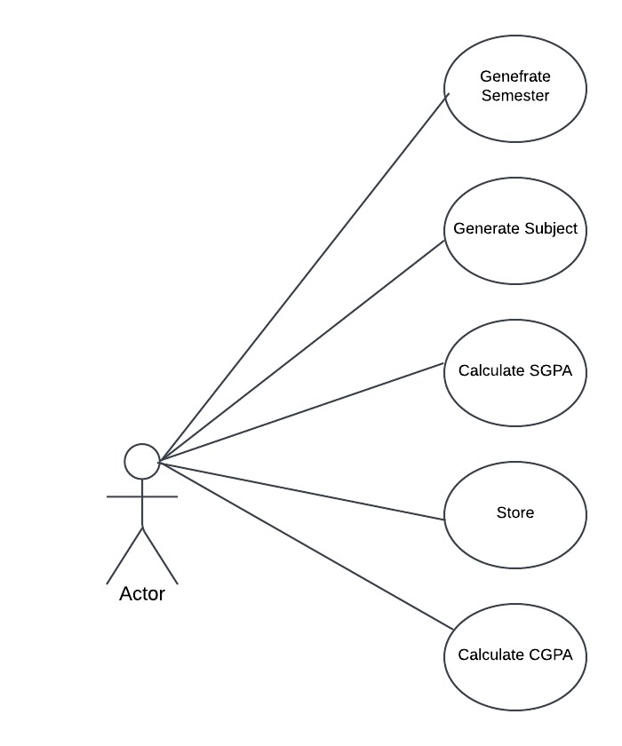
PROPOSED SYSTEM ARCHITECTURE
User/ Actor is intended to calculate CGPA He can directly enter semesters and
it’s respective marks

Slide 7
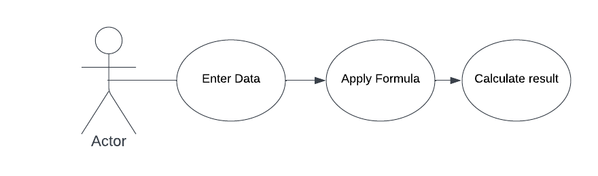
EXISTING SYSTEM ARCHITECTURE
Example: Calculation with Excel sheets, using Simple Calculator

Slide 8
SOFTWARE AND HARDWARE REQUIREMENTS
HARDWARE
SOFTWARE
Processor: Quad-core processor (1.5 GHz or higher)​
Recommended: Octa-core processor (2.0 GHz or higher)​
RAM:2 GB​
Recommended: 4 GB or higher​
Storage: 50 MB of free storage space​
Additional space for user data, logs, or backups as needed​
Display :4.5-inch screen with 720p resolution​
Recommended: 5.5-inch or larger screen with Full HD (1080p) resolution​
Operating System : Android 5.0 (Lollipop)​
Recommended: Android 9.0 (Pie) or higher​
Battery : Minimum 2000 mAh capacity
Android Studio: Version Arctic Fox (2020.3.1) or higher.​
JDK (Java Development Kit): Version 8 or higher.​
Programming Languages: Java, XML.​
Frameworks & Libraries:​
Android SDK: API Level 21 or higher (for Lollipop and above).​
Gradle: Latest version for building and managing dependencies.​
Database: For saving user progress, SQLite can be integrated.​
Third-party Libraries​

Slide 9
MODULES
Input Module​
SGPA Calculation Module​
CGPA Calculation Module​
User Interface Module​
Data Storage and Processing Module​

Slide 10
SUMMARY OF MODULE-1
Purpose: Collects essential data such as the number of semesters, subjects, grades, and credit hours.​
Features: Dynamically generates input fields based on user input and validates entries in real-time to ensure accuracy and completeness.
Conclusion: The module simplifies and streamlines the data collection process by dynamically generating input fields and validating user entries, ensuring accurate and efficient academic data input for SGPA and CGPA calculations.​

Slide 11
SUMMARY OF MODULE-2
Purpose: Calculates the Semester Grade Point Average (SGPA) for individual semesters.​
Features: Multiplies grades by credit hours, sums up results, and divides by total credits. Includes real-time validation and error handling for invalid or incomplete data.​
Conclusion: The SGPA calculation module ensures accurate and efficient computation of Semester Grade Point Averages by automating calculations, validating data in real-time, and providing error handling for a smooth user experience.

Slide 12
SUMMARY OF MODULE-3
Purpose: Computes the Cumulative Grade Point Average (CGPA) across multiple semesters.​
Features: Uses the total grade points and credits from all semesters. Ensures error-free calculations and displays results dynamically.​
Conclusion: The CGPA calculation module provides a reliable and dynamic approach to computing cumulative academic performance, ensuring accuracy and efficiency by consolidating data across multiple semesters while handling errors seamlessly.

Slide 13
SUMMARY OF MODULE-4
Purpose: Creates a user-friendly and responsive graphical interface for smooth interaction.​
Features: Organizes input fields, buttons, and result displays logically. Ensures a seamless user experience with intuitive navigation.​
Conclusion: The user interface module provides a seamless and intuitive experience by organizing components logically and ensuring responsive interaction, enhancing usability and accessibility for users.

Slide 14
SUMMARY OF MODULE-5
Purpose: To securely store user inputs and perform efficient data processing for accurate SGPA and CGPA calculations.
Features: Safely stores input, processes data for calculations, ensures compatibility
with various grading systems, and supports seamless retrieval for real-time results.
Conclusion: The data storage and processing module ensures reliable handling of user inputs, securely storing and systematically processing data to facilitate accurate calculations and seamless academic performance analysis.

Slide 15
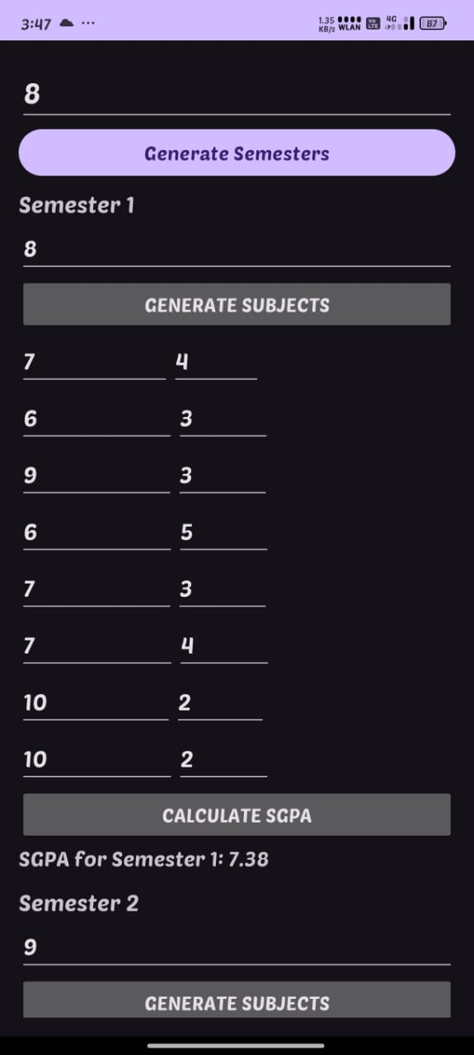
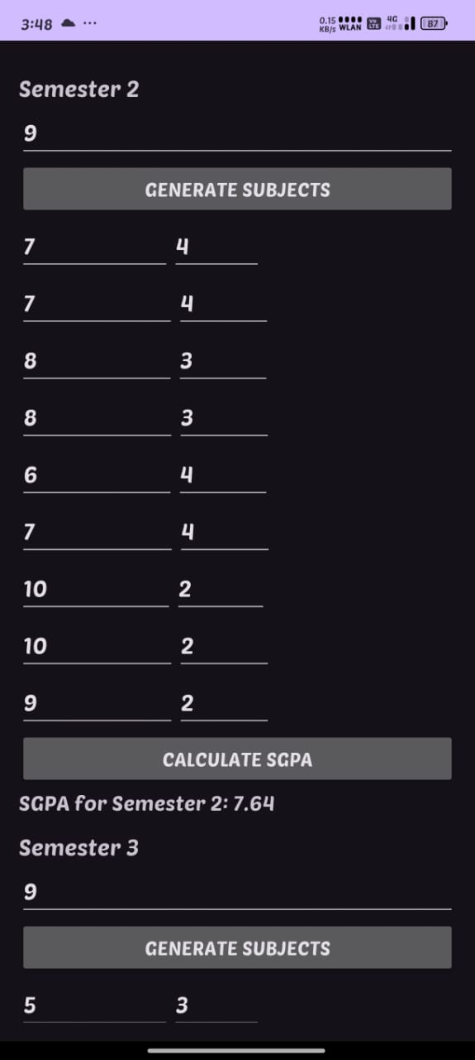
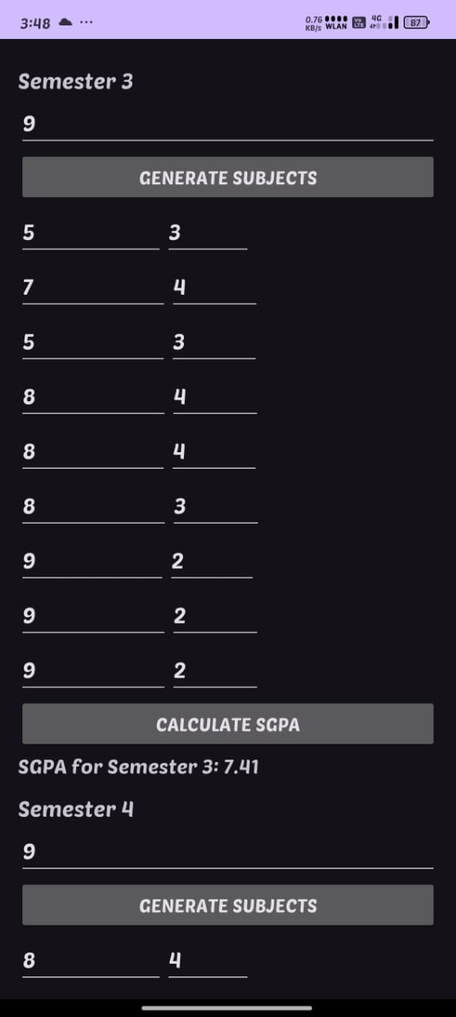
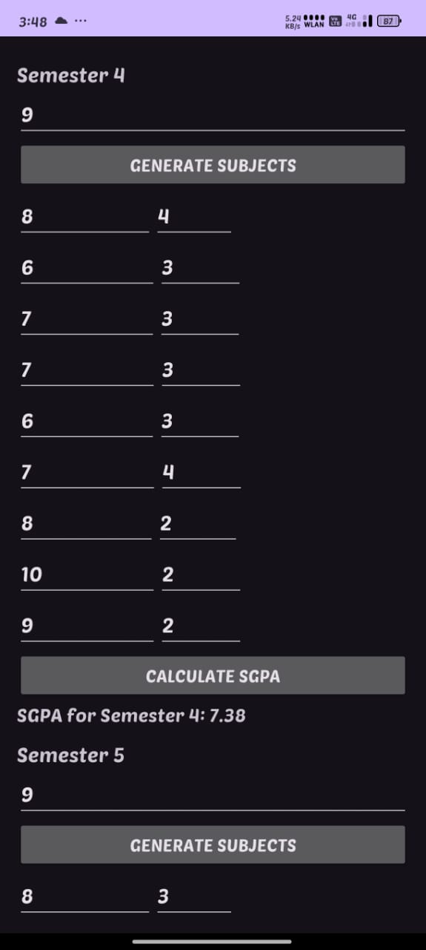
RESULTS AND DISCUSSION
1stsemester calculation
2nd semester calculation
3rd semester calculation
4th semester calculation

Slide 16
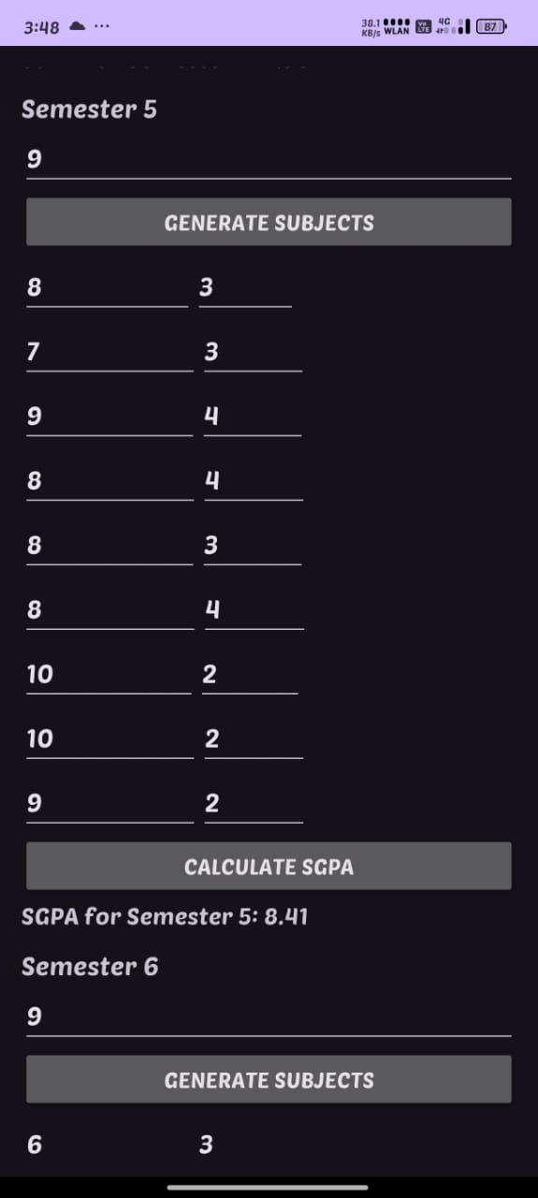
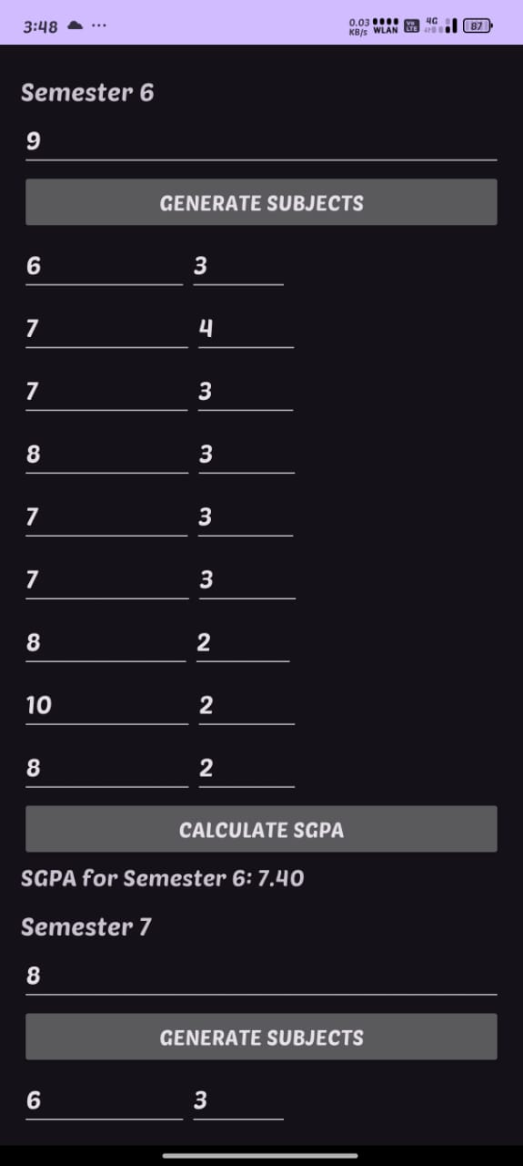
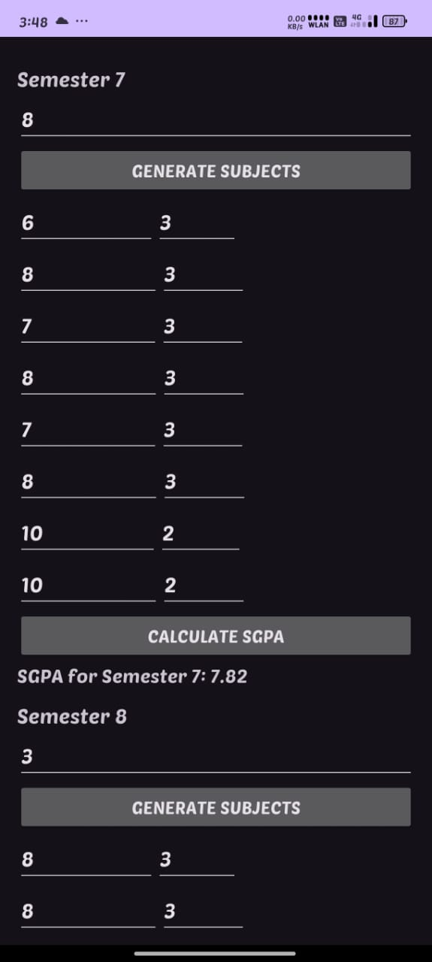
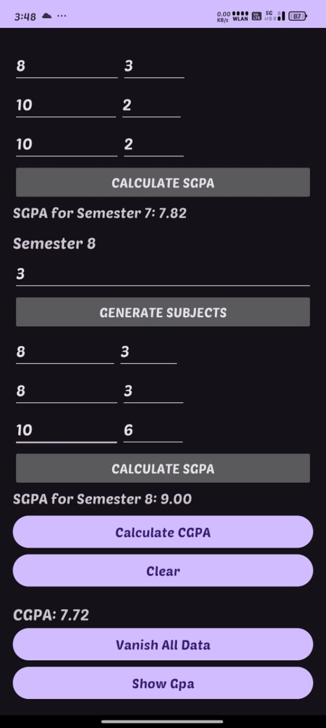
RESULTS AND DISCUSSION
5th semester calculation
6th semester calculation
7th semester calculation
8th semester calculation
And CGPA Calculation

Slide 17
CONCLUSION
Simplifies SGPA and CGPA calculations by automating the process, ensuring accuracy and saving time.​
Provides a user-friendly and intuitive interface, making it accessible for students and educators.​
Adapts to diverse academic systems, accommodating varying grading structures and credit schemes.​
Enhances reliability through features like real-time validation, error handling, and precise calculations.​
Offers significant potential for future improvements, including cloud integration, data visualization, and cross-platform compatibility​

Slide 18
THANK YOU

